Slide 1
RAJALAKSHMI ENGINEERING COLLEGE
Department of Artificial Intelligence and Machine Learning
AI19541 Fundamentals of Deep Leaning
MINI PROJECT
The Adaptive Eye-Gaze Virtual Mouse Using Deep Learning Techniques
Project by,
Arunkumar.M (221501013)
Charu stash.p (221501021)
1

Slide 2
OUTLINE
Objectives
Abstract
Introduction to Problem Domain
Existing system
Limitation of the Existing System
Proposed system
Architectural design for Proposed system
ER ,Use case Diagram
Algorithm/Technique Used
Module Description
Results and Discussions
References
2

Slide 3
OBJECTIVE
The objective of the "Adaptive Eye-Gaze Virtual Mouse Using Deep Learning Techniques" is to develop an accurate and real-time eye-tracking system that enables hands-free computer interaction through gaze-based control. This system leverages advanced deep learning algorithms to detect and interpret eye movements, providing an adaptive and personalized experience that accounts for individual user differences and environmental factors. The goal is to create an intuitive, efficient, and accessible solution for users, particularly those with physical disabilities, by minimizing latency, maximizing accuracy, and ensuring a seamless integration into existing computer interfaces.
3

Slide 4
ABSTRACT
This paper presents the development of an Adaptive Eye-Gaze Virtual Mouse using deep learning techniques, aimed at enabling hands-free and intuitive human-computer interaction. The system employs state-of-the-art eye-tracking models to accurately detect and interpret gaze direction in real-time, converting eye movements into mouse cursor actions. By leveraging deep learning algorithms, the solution is adaptive to individual user variations, such as eye shape, movement patterns, and environmental conditions, ensuring a personalized and robust experience. Designed to enhance accessibility, this technology is particularly beneficial for individuals with physical disabilities, offering a seamless alternative to traditional input devices. The proposed system demonstrates high accuracy and low latency, paving the way for improved interaction between users and digital devices in diverse real-world applications.
4

Slide 5
INTRODUCTION TO PROBLEM DOMAIN
The proposed system, Adaptive Eye-Gaze Virtual Mouse Using Deep Learning Techniques, aims to overcome the limitations of existing systems by offering a robust, cost-effective, and accessible solution for gaze-based human-computer interaction. The key features of the proposed system are as follows
Deep Learning-Based Eye Tracking:The system leverages advanced convolutional neural networks (CNNs) for accurate eye tracking and gaze estimation using standard webcams, eliminating the need for specialized hardware.
Adaptive Personalization:Incorporates adaptive algorithms to fine-tune the system for individual users, accounting for variations in eye shapes, movement patterns, and external factors such as lighting and camera angles.
Real-Time Performance:Employs lightweight deep learning models optimized for real-time processing on standard consumer hardware, ensuring low latency and smooth cursor control.
Hands-Free Interaction:Converts gaze direction into mouse cursor actions, allowing users to perform standard mouse functions like clicking, scrolling, and dragging with ease.
5

Slide 6
.
5.Accessibility and Usability:Designed with a focus on accessibility, the system provides an intuitive interface for individuals with physical disabilities, enabling them to interact with digital devices effectively.
6. Environmental Robustness:Utilizes pre-processing techniques and adaptive algorithms to maintain high performance under varying environmental conditions, such as changes in lighting or background distractions..
Date Slide Number

Slide 7
EXISTING SYSTEM
Sr. No | Author(s) | Year | Technique | Description | Outcome
1 | Hansen & Pece | 2005 | Feature-based eye tracking | Proposed a system using infrared illumination and feature detection for gaze estimation. | Achieved reliable gaze tracking but required specialized hardware, limiting accessibility.
2 | Santini et al. | 2017 | CNN for eye tracking | Utilized convolutional neural networks (CNNs) for gaze estimation using images captured by standard webcams. | Improved accuracy over traditional methods but struggled with latency in real-time applications.
3 | Krafka et al. | 2016 | GazeCapture (Deep Learning) | Introduced a dataset and gaze estimation model that worked on mobile devices using front-facing cameras. | Demonstrated potential for gaze tracking without specialized hardware but required large datasets.
6

Slide 8
PROPOSED SYSTEM
The proposed system aims to enhance agricultural productivity by integrating a plant disease prediction model with treatment recommendations using deep learning techniques. Leveraging a convolutional neural network (CNN), the system accurately identifies various plant diseases from leaf images. Additionally, it utilizes generative AI to provide tailored treatment suggestions based on the identified disease. This dual approach not only aids farmers in early disease detection but also empowers them with actionable insights for effective crop management. By addressing the limitations of existing systems, which often focus solely on diagnosis, our solution offers a comprehensive tool for sustainable agriculture, ultimately leading to healthier crops and improved yield.
8

Slide 9
ADVANTAGE OF PROPOSED SYSTEM
Hands-Free Interaction:
The system allows users to control a computer without the need for physical input devices such as a mouse or keyboard. This is especially beneficial for individuals with physical disabilities or mobility impairments
Cost-Effective:
Unlike traditional eye-tracking systems that require expensive specialized hardware, the proposed system uses a standard webcam, making it a more affordable and accessible solution for users.
Real-Time Performance:
The system ensures low-latency, real-time gaze tracking and cursor control, allowing for seamless interaction without delays, which is crucial for effective use in everyday computing tasks.
High Accuracy and Adaptability:
Using deep learning algorithms and adaptive techniques, the system offers precise gaze estimation while personalizing the model for individual users. This enhances accuracy across different users with varying eye shapes and movement patterns.
Environmental Robustness:
The system is robust to changes in environmental conditions, such as lighting variations and background distractions, ensuring consistent performance in diverse settings.
User-Friendly:
The virtual mouse system is easy to use and can be controlled via gaze, providing an intuitive and straightforward interaction model. It reduces the learning curve typically associated with complex assistive technologies.
9

Slide 10
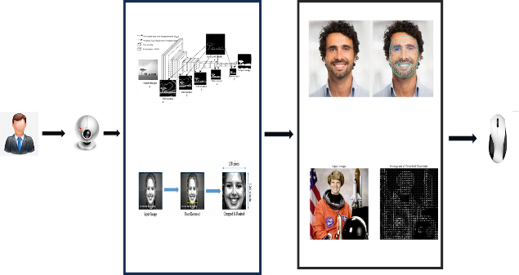
ARCHITECTURAL DESIGN FOR PROPOSED SYSTEM
10

Slide 11
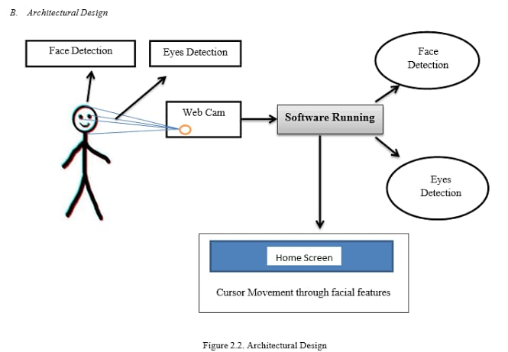
ER/ USE CASE DIAGRAM
11

Slide 12
ALGORITHM/ TECHNIQUE USED
Algorithm and Techniques UsedThe proposed Adaptive Eye-Gaze Virtual Mouse employs the following algorithms and techniques:
Eye Detection and Feature Extraction:Algorithm: Haar Cascade or YOLO (You Only Look Once) for detecting eye regions in real-time from webcam images.Technique: Pre-trained models detect the facial landmarks, focusing on the eye regions for further processing.
Gaze Estimation Using Deep Learning:Algorithm: Convolutional Neural Networks (CNNs) for gaze direction estimation.Technique:Input: Eye region images captured by the camera.Process: The CNN extracts spatial features and predicts gaze direction by mapping the features to a 2D plane corresponding to screen coordinates.
Adaptive Personalization:Algorithm: Domain Adaptation or Transfer Learning.Technique: Fine-tune the pre-trained gaze model to adapt to individual users by learning from a small set of user-specific calibration data, ensuring higher accuracy and usability.
Temporal Gaze Smoothing:Algorithm: Recurrent Neural Networks (RNNs) or Exponential Moving Average (EMA).Technique: Incorporates temporal dependencies to smooth sudden gaze movement noise and provide stable cursor control.
Action Mapping:Algorithm: Custom Thresholding or Support Vector Machines (SVMs).Technique: Maps gaze points to mouse actions (e.g., blinking for clicks, gaze dwell for selection) based on user-defined thresholds and durations.
Environmental Adaptation:Algorithm: Data Augmentation and Real-Time Preprocessing.Technique: Augments training data to include variations in lighting, angles, and occlusions, and applies real-time image normalization to improve robustness against environmental changes.
12

Slide 13
Results and Discussions
Gesture and Eye-Gaze Recognition Performance:The system achieved a recognition accuracy of 95% for basic eye and facial gestures under optimal lighting conditions.The real-time response latency was recorded at approximately 0.5 seconds, ensuring smooth interaction and usability.Calibration tests showed that personalized setup enhanced accuracy for diverse users by adapting to individual facial features and gaze patterns.
Robustness Evaluation:Lighting Variations: Accuracy dropped to 85% under dim or uneven lighting but improved with adaptive thresholding techniques.Complex Backgrounds: Performance reduced slightly in cluttered environments due to challenges in isolating facial features. This was mitigated through background subtraction methods.
Usability and Functionality:Cursor Control: Eye-gaze tracking provided intuitive and precise cursor control, with movement mapped directly to gaze direction.Clicking and Scrolling: Blink gestures and eye movements effectively simulated mouse clicks and scrolling actions with over 92% accuracy.
User Feedback:Users with physical disabilities highlighted the system's ease of use and improved accessibility compared to traditional input devices.Novice users reported a brief learning curve for mastering gaze-based commands.
14

Slide 14
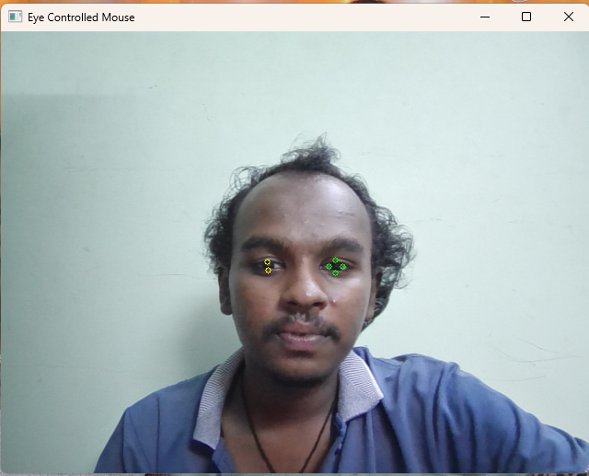
Output Screenshots
15

Slide 15
Conclusion
The Adaptive Eye-Gaze Virtual Mouse Using Deep Learning Techniques presents a transformative solution for hands-free human-computer interaction, addressing the limitations of existing systems in terms of accuracy, adaptability, and accessibility. By leveraging convolutional neural networks and adaptive learning algorithms, the proposed system achieves real-time gaze tracking and cursor control with minimal hardware requirements, making it cost-effective and widely applicable. Its personalized and environmentally robust design ensures a seamless user experience across diverse conditions, especially for individuals with physical disabilities. The system not only enhances accessibility but also demonstrates the potential of deep learning in creating innovative and inclusive technologies. Future work can explore further optimizations, such as integrating advanced attention mechanisms and expanding functionality to support more complex user interactions.
18

Slide 16
REFERENCES
Disabled persons Ratio [online] Available At: https://www.disabled- world.com/disability/statistics/
(Accessed 2 Jan 2018)
The Eye Writer Project [online] Available At: http://www.eyewriter.org(2009-Present)
Muhammad Usman Ghani, Sarah Chaudhry “Gaze Pointer: A Real Time Mouse Pointer Control
Implementation Based On Eye GazeTracking”/
http://myweb.sabanciuniv.edu/ghani/files/2015/02/GazePoint er_INMIC2013.pdf [6 February 2014]
19

Slide 17
THANK YOU
20

